Slide 1
Rising Star Update
Lin, Yuchen, Chengxi
Sept 12, 2017

Slide 2
Agenda
Background and Motivation
Exploratory Data Analysis
Methodology
Result:
- trend
- K-means

Slide 3
Exploratory Data Analysis
Original variables/features
13 tables
Address
Affiliation
Events
Profile
Education
Press
Publication
Around 100 variables

Slide 4
Exploratory Data Analysis
Derivative variables/features
HBE Universal Code
Publication Year
Article Title
Journal Name
Journal H-index
Position
Author List

Slide 5
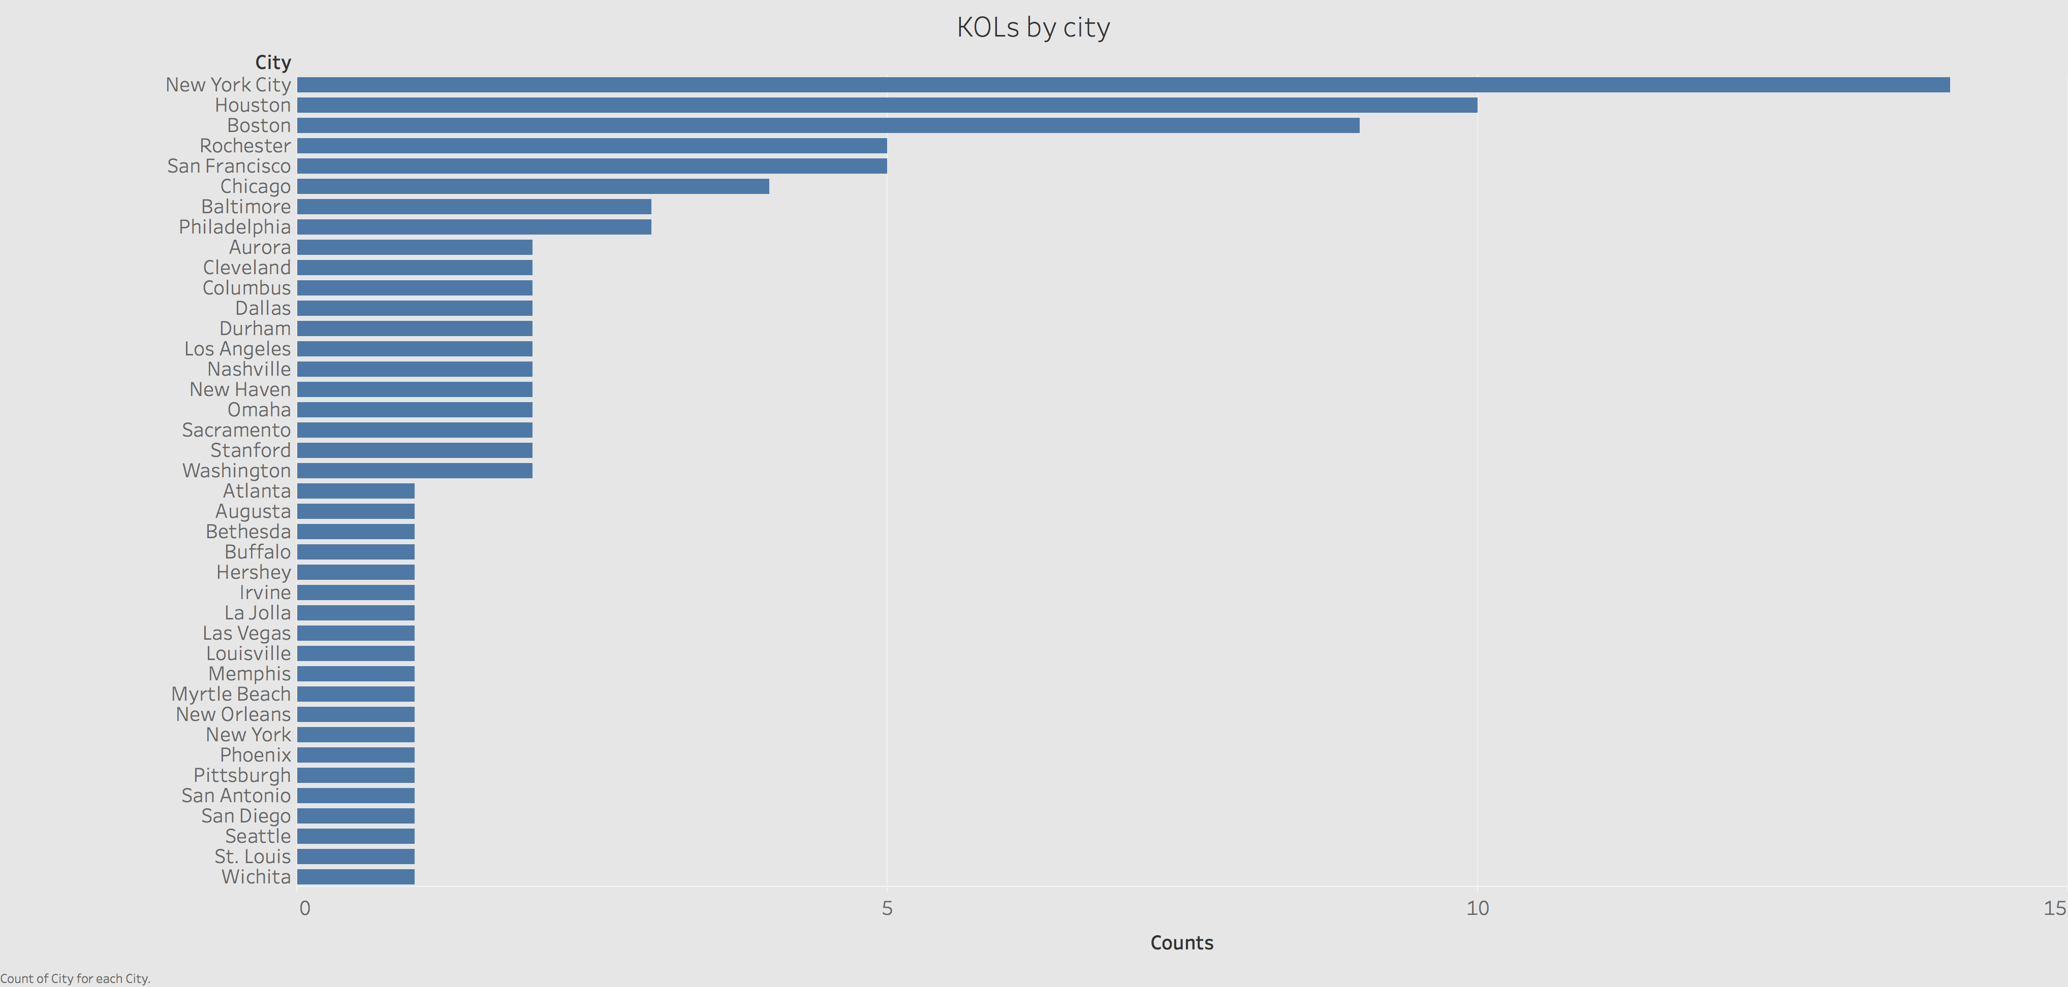

Slide 6
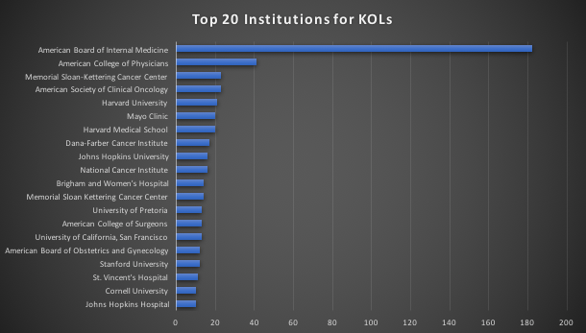
Exploratory Data Analysis

Slide 7
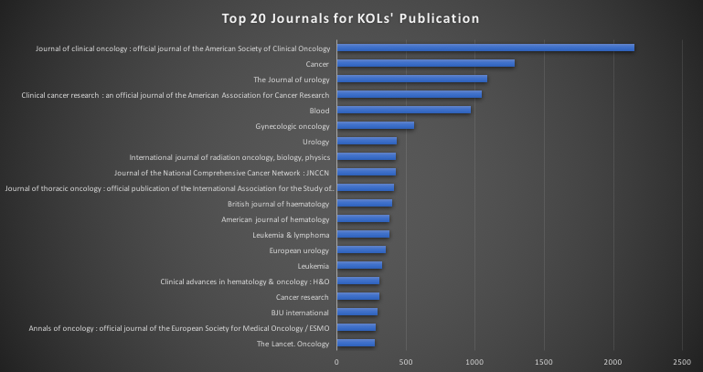
Exploratory Data Analysis

Slide 8
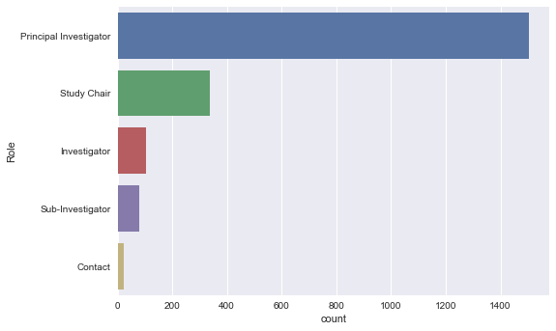
Exploratory Data Analysis

Slide 9
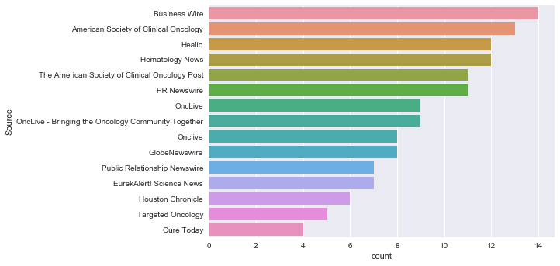
Exploratory Data Analysis

Slide 10
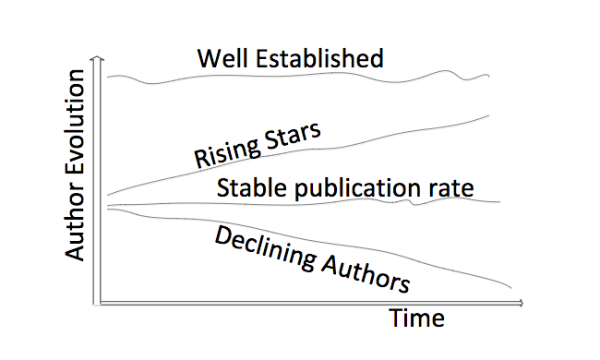

Definition of rising star
Analyze the trends and patterns behind KOL
Predict the probability of an individual to be KOL
$$∇P$$
Rising Stars
Declining Authors
Well Established
Production P
FIG: Four basic author’s evolution behavior over time (Tsatsaronis et al. 2011)
Notes:
Define the problem here: what to model
Rising star

Slide 11
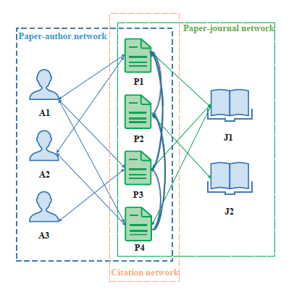
State of Art
PageRank
Supervised Learning
Clustering
Identifying the Academic Rising Stars arXiv:1606.05752 [cs.DL]

Slide 12
Capture the trends

Slide 13
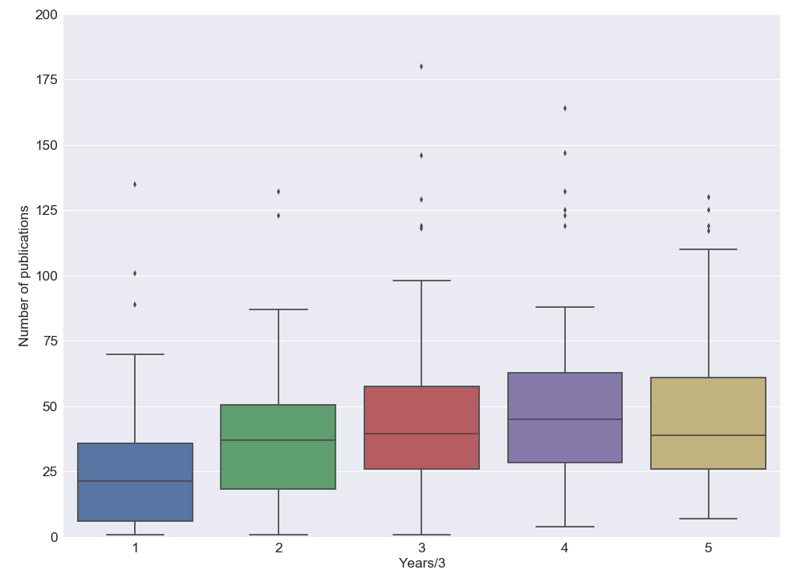
Production stats in early career
0-3
3-6
6-9
9-12
12-15
Years in career

Slide 14
Publication Trends to Identify Rising Stars
Average publication trend for top 100 KOLs
Testing candidate
76 Non-KOL +
85 KOL
Above benchmark
Benchmark
Average publication trend for bottom 30 KOLs
Rising star?
Number of Publications
Age ?
31 rising stars as Age <=55
Time (in Years) since First Publication was authored
Notes:
The first 10 years for researchers are very important for their career and usually is good window to observe the rising stars. We calculated the tri-yearly publication number for top 100 KOLs and bottom 30 KOLs. The time window is selected as first 12 years since most physician have records for this length of period. We use the bottom 30 KOLs as a benchmark for KOLs. What’s a good index for rising star compared to KOL? I think age is an important factor in business sense. So we estimate the age from graduate end year. We label those with Age <=55 as the rising stars. There are 31 of them, ~6%. The age could be adjusted to 50, which gives us 18 of rising stars. Next we can calculate the probability of becoming rising star at time point t.

Slide 15
Results validation
Memorial Sloan Kettering Cancer Center
HBE_ID | Title | SJR_sum | first_pub year | KOL | SJR_10 | npaper | Event Counts | Mean SJR | pub_3 | pub_6 | pub_9 | pub_12 | Graduate_End_Date
HBE_IDN_6051074 | Chair Director | 1574.353 | 2009 | Rising star | 1574.353 | 219 | 53 | 196 | 56 | 97 | 66 | 0 | 1999
HBE_IDN_5002749 | Medical Director | 351.288 | 2006 | KOL | 341.722 | 129 | 172 | 31.0 | 27 | 27 | 42 | 40 | 1984
More validation needed

Slide 16
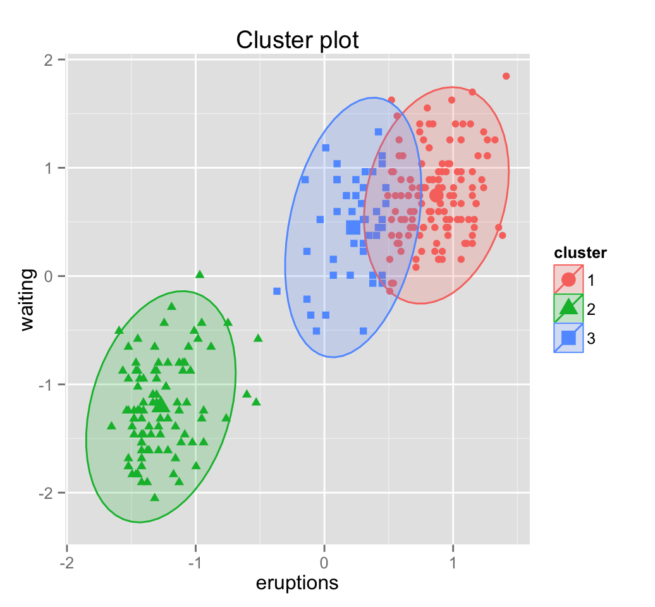
Methodology
KOL
Indices
Rising stars
Clustering Method: K-means
100 labeled KOL samples
500 unlabeled unknow samples
Features Selection:
SJR score
press_count
event_count
trials_count
Non-KOL
Indices
Notes:
Supervised learning is not applicable due to the absence of manually annotated data(rising stars) for this task

Slide 17
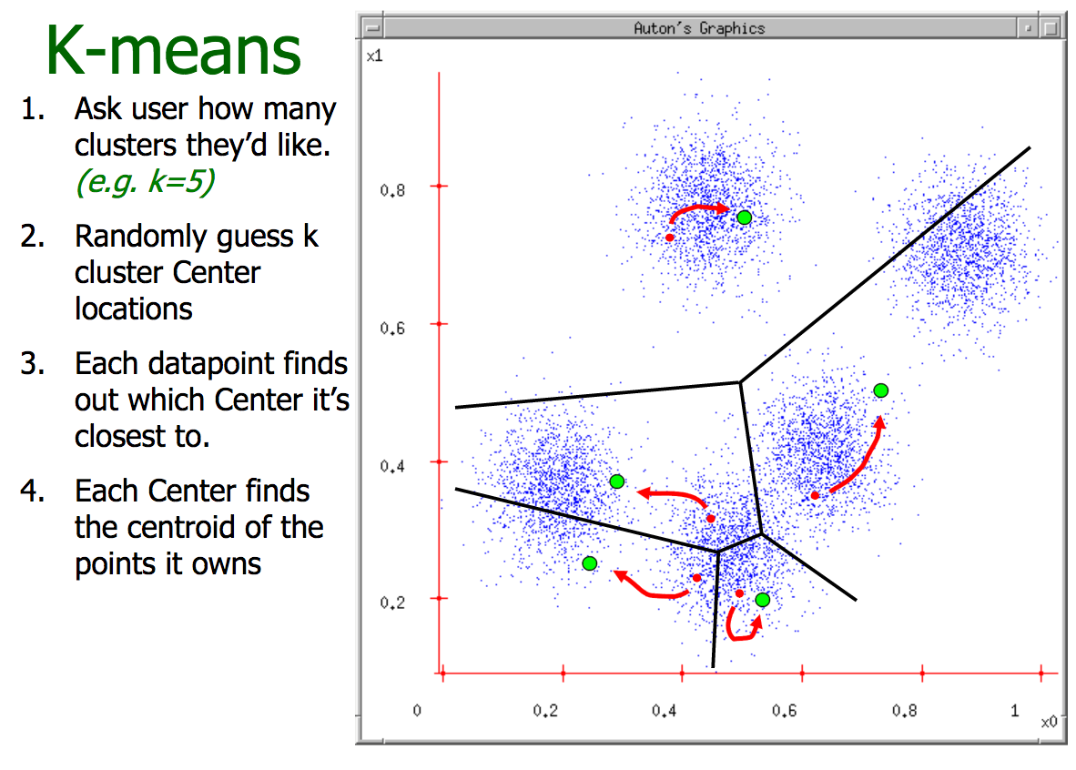
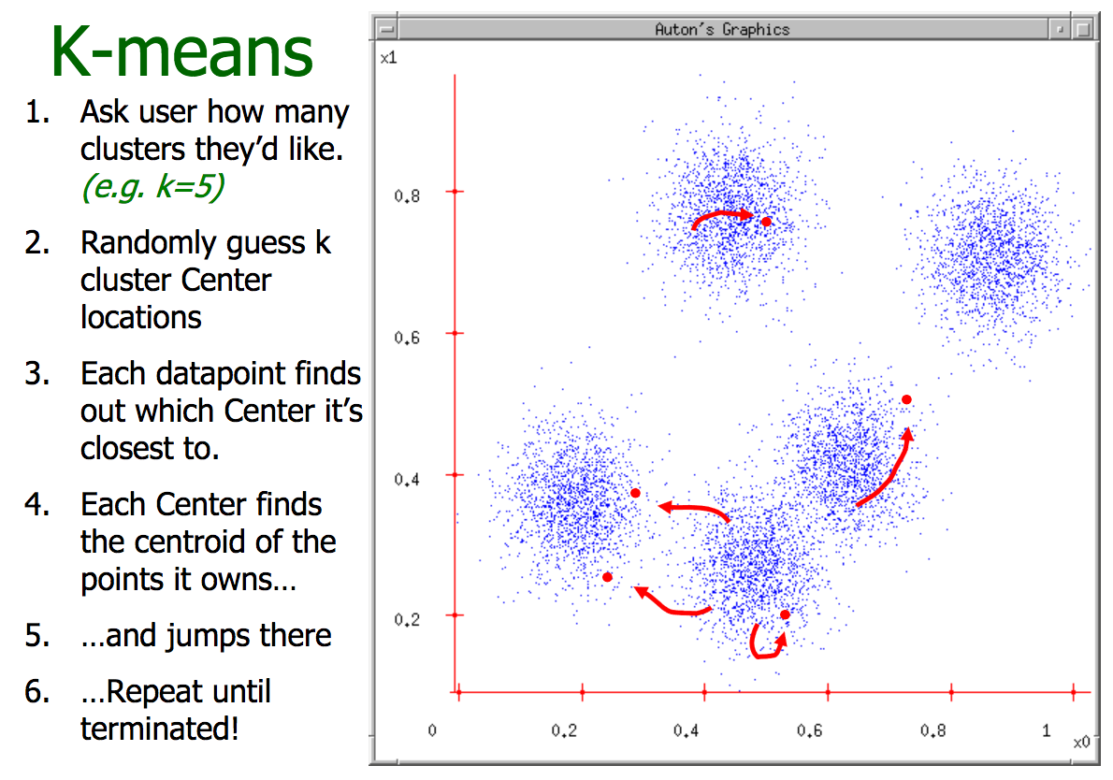
Introduction to K-means
http://www.cs.cmu.edu/~./awm/tutorials/kmeans11.pdf

Slide 18
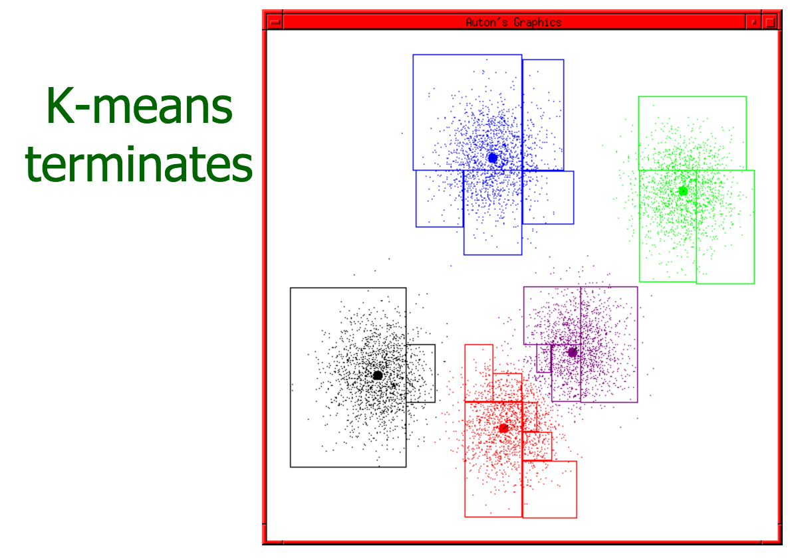
Introduction to K-means
http://www.cs.cmu.edu/~./awm/tutorials/kmeans11.pdf

Slide 19
K-means Modeling
Selecting the number of clusters using silhouette analysis
Silhouette analysis can be used to study the separation distance between the resulting clusters.
K = 5
K = 4
K = 3
K = 2
Samples close to decision boundary
Samples far away from neighboring clusters
0
1
0.50
0.55
0.58
0.64
http://scikit-learn.org/stable/auto_examples/cluster/plot_kmeans_silhouette_analysis.html

Slide 20
Results and Validation
Confusion matrix:
KOL = 1, Others = 0
N = 501 | Predict: 0 | Predict: 1
Annotated: 0 | TN = 362 | FP = 54
Annotated: 1 | FN = 30 | TP = 57

Slide 21
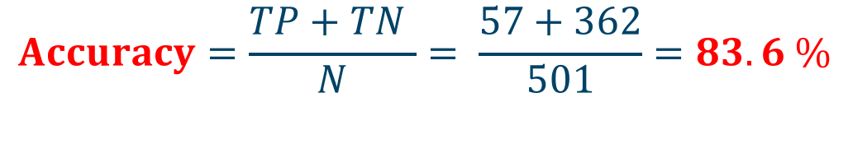
Results and Validation
Confusion matrix: KOL = 1, Others = 0
N = 501 | Predict: 0 | Predict: 1
Annotated: 0 | TN = 362 | FP = 54
Annotated: 1 | FN = 30 | TP = 57
$$Accuracy=\frac{TP+TN }{N}= \frac{57+362}{501}=83.6 \%$$

Slide 22
Results and Validation
Rising Star Definition: who is predict to be KOL but was not manually annotated, which is FP group in confusion matrix.
N = 501 | Predict: 0 | Predict: 1
Annotated: 0 | TN = 362 | FP = 54
Annotated: 1 | FN = 30 | TP = 57
Rising star(FP) = 54
Rising stars: FP = 54
Percentage of Rising Stars: 54/501 = 10.8%

Slide 23
Results and Validation

Slide 24
Results and Validation
ID | SJR score | press_count | event_count | trials_count
HBE_UR_00008 | 753.495 | 45 | 32 | 9
HBE_IDN_5002127 | 818.145 | 18 | 38 | 20
HBE_IDN_5002891 | 747.49 | 6 | 26 | 13
HBE_ONC_1002893 | 924.432 | 0 | 122 | 53
HBE_ONC_1000504 | 752.811 | 0 | 61 | 46
HBE_ONC_1000509 | 950.315 | 0 | 40 | 42
HBE_IDN_5002200 | 779.395 | 0 | 32 | 38
7 rising stars according to our model

Slide 25
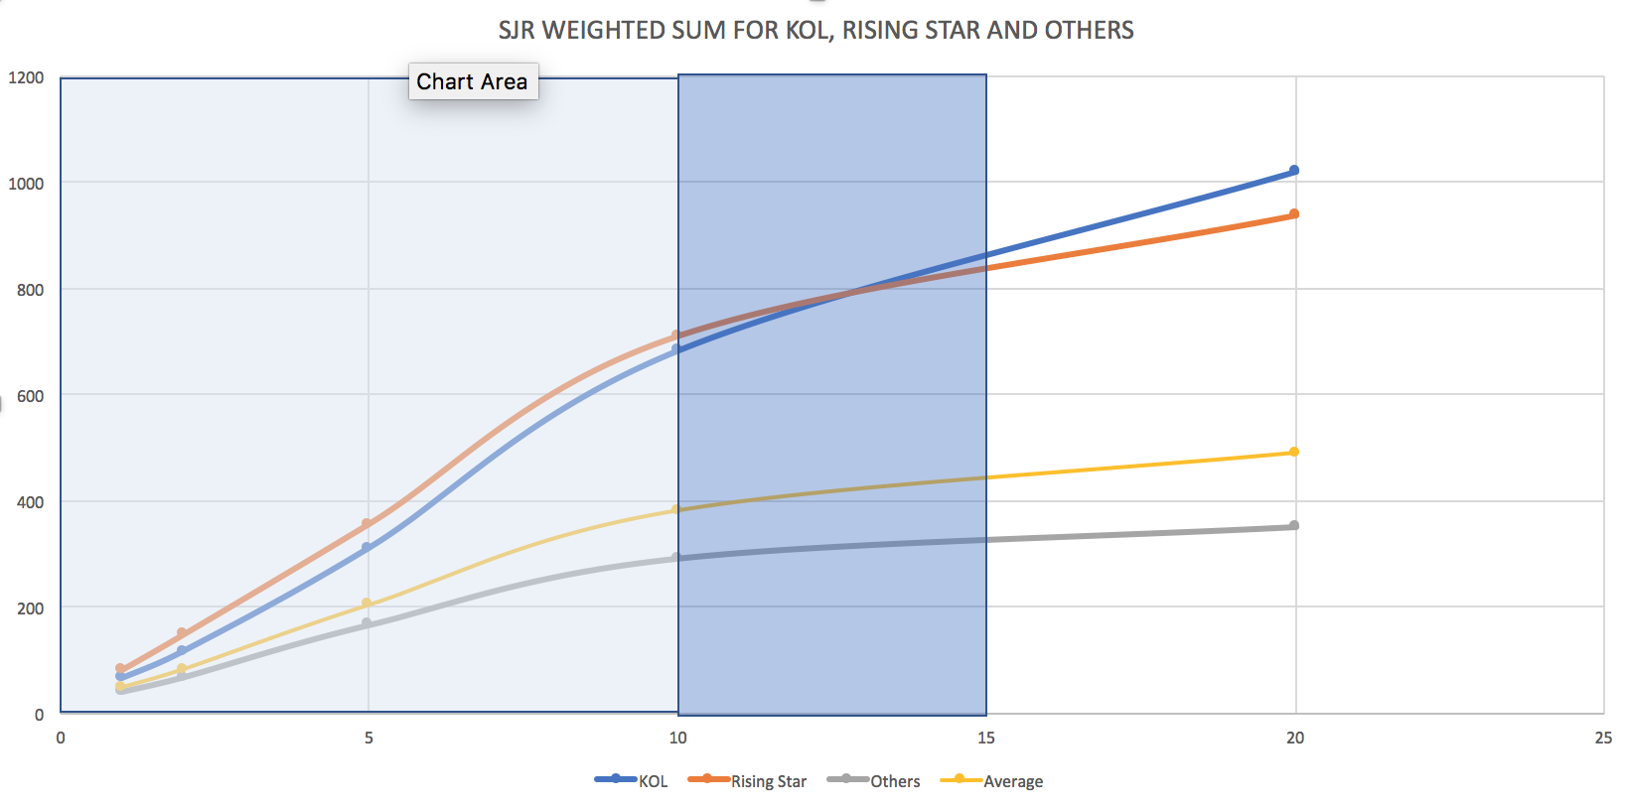
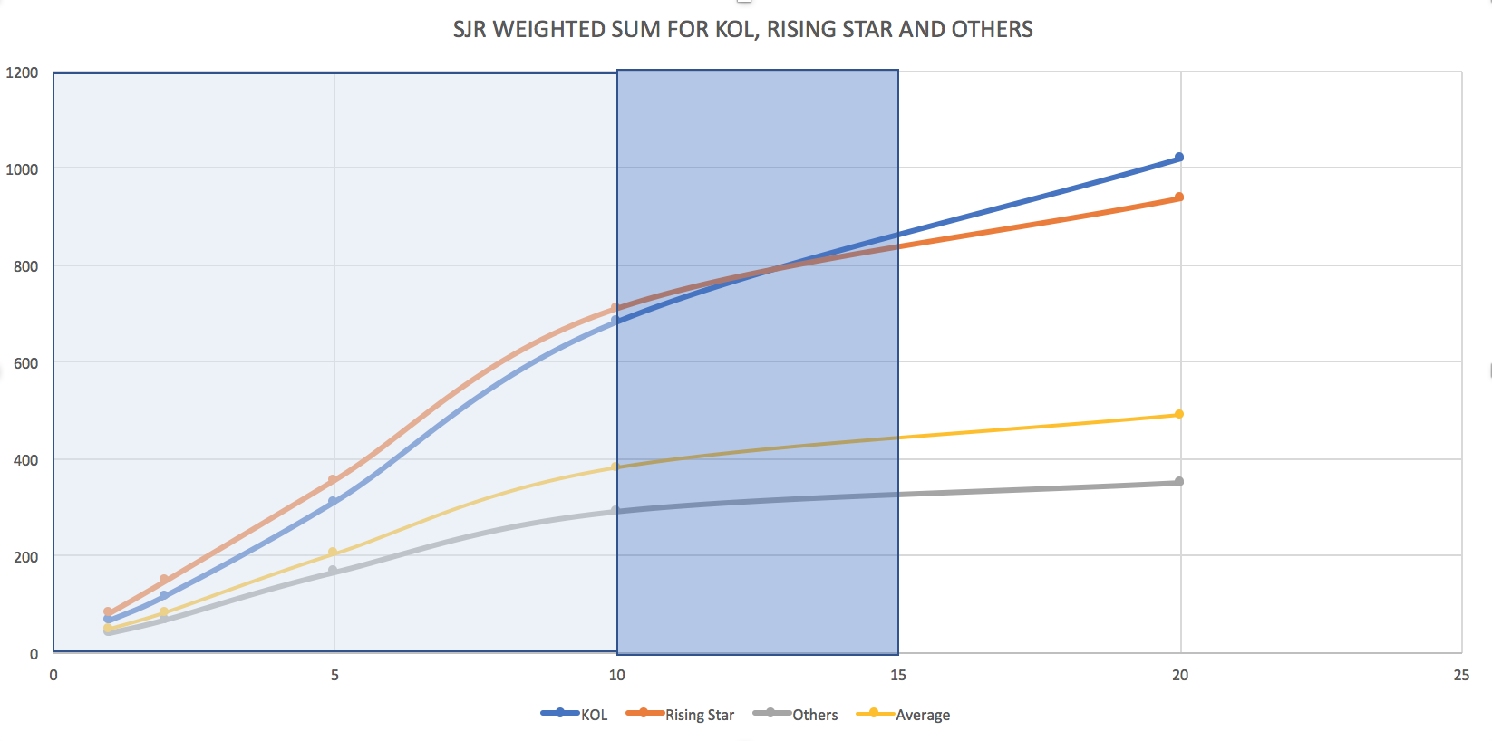
Results and Validation
Year since first publication

